Slide 1
Highway Planning & Design
Lecture - 7
Designed and presented
By
Asst. Prof. Dr. Raquim Nihad Zehawi

Slide 2
HORIZONTAL CURVES
Four types of horizontal curves:
1- Simple - curve with single constant radius.

Slide 3
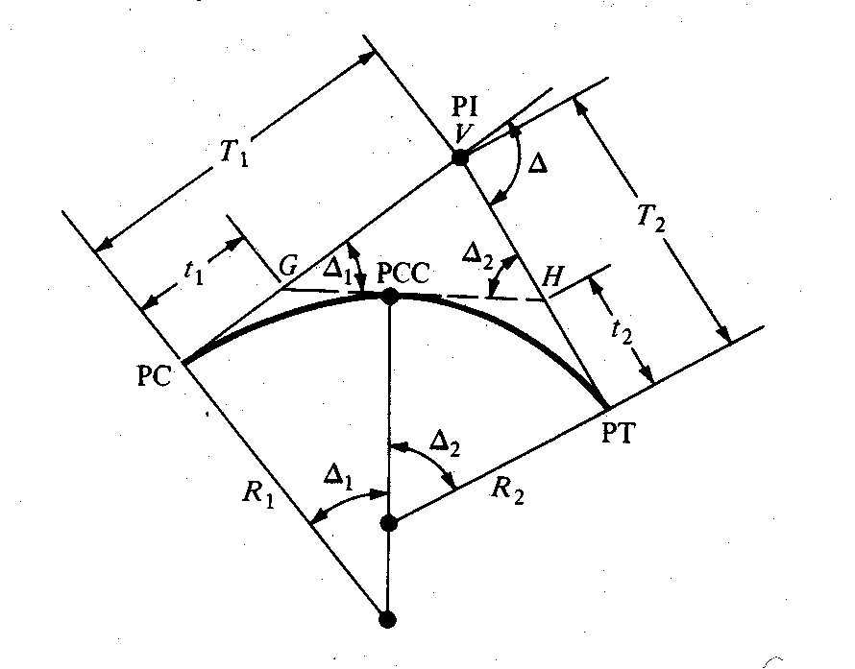
2- Compound – two or more
curves in succession, turning in
the same direction.

Slide 4
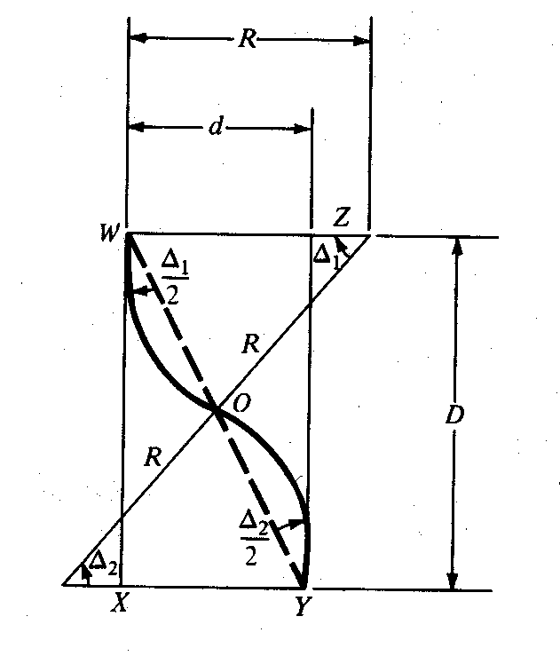
3- Reverse – two simple curves with equal radii
turning in opposite directions with a
common tangent.

Slide 5
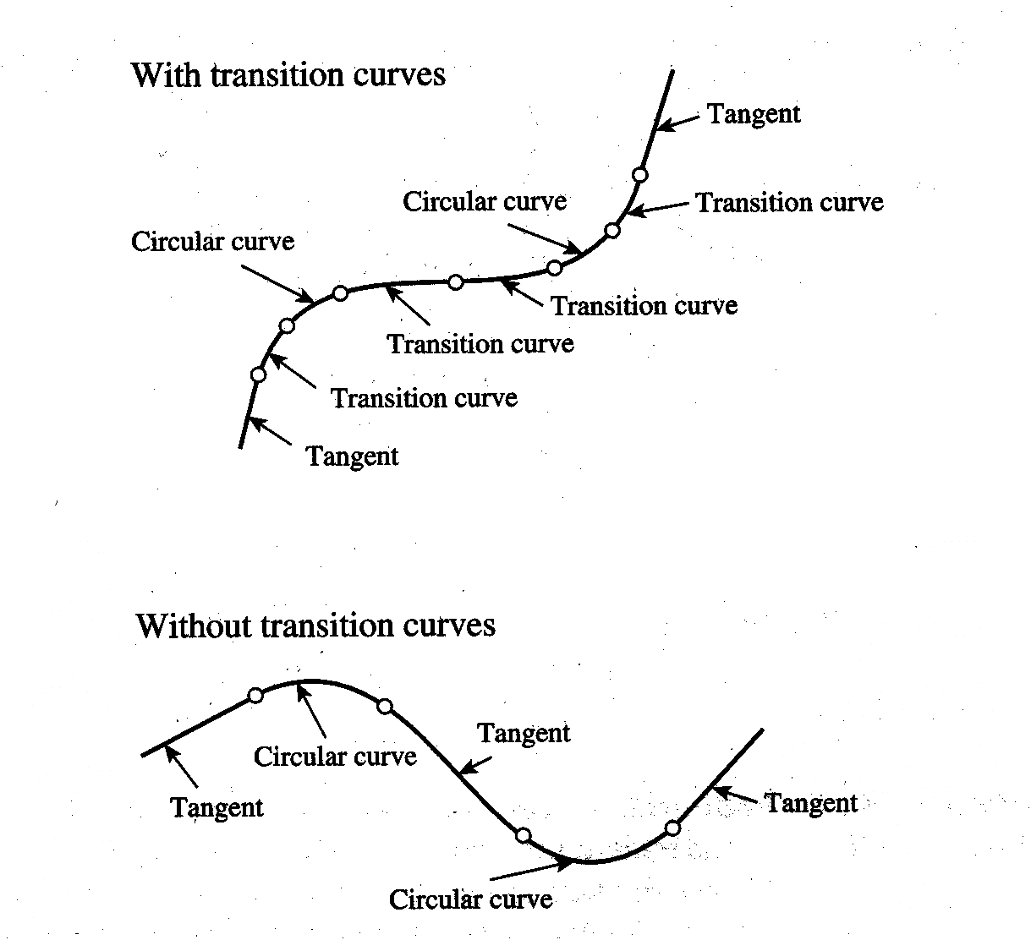
4- Spiral – also called transition curves;
placed between tangents and circular
curves or between two adjacent circular
curves having substantially different
radii.

Slide 6
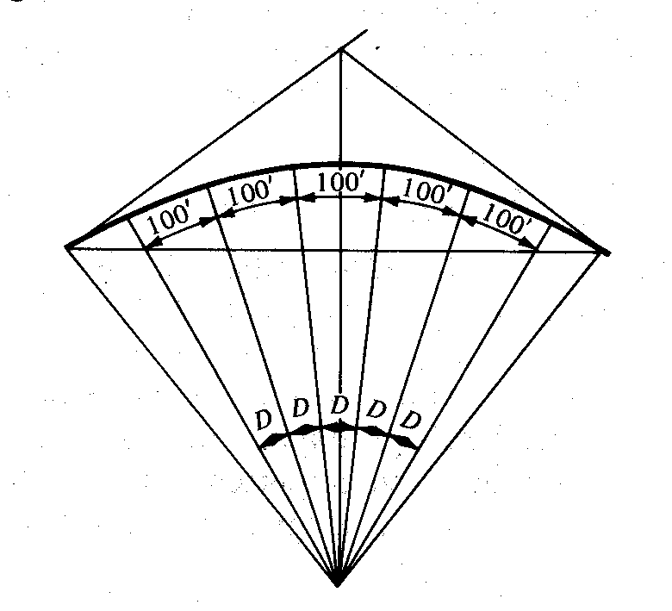
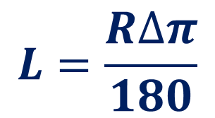
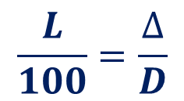
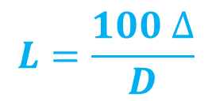
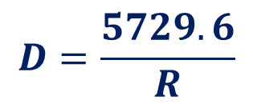
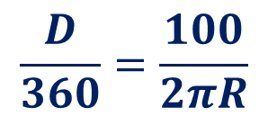
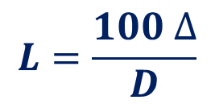
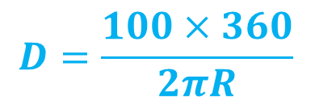
Horizontal Curve Formulas
Degree of Curve (D) – angle subtended by 100 ft or meter arc, along horizontal curve
It is a measure of the sharpness of the curve
$$\frac{L}{100}=\frac{∆}{D}$$
$$L=\frac{100 ∆}{D}$$
$$\frac{D}{360}=\frac{100}{2πR}$$
$$D=\frac{5729.6}{R}$$
degree of curve can be determined if the radius is known
$$L=\frac{100 ∆}{D}$$
$$L=\frac{R∆π}{180}$$
$$D=\frac{100×360}{2πR}$$

Slide 7
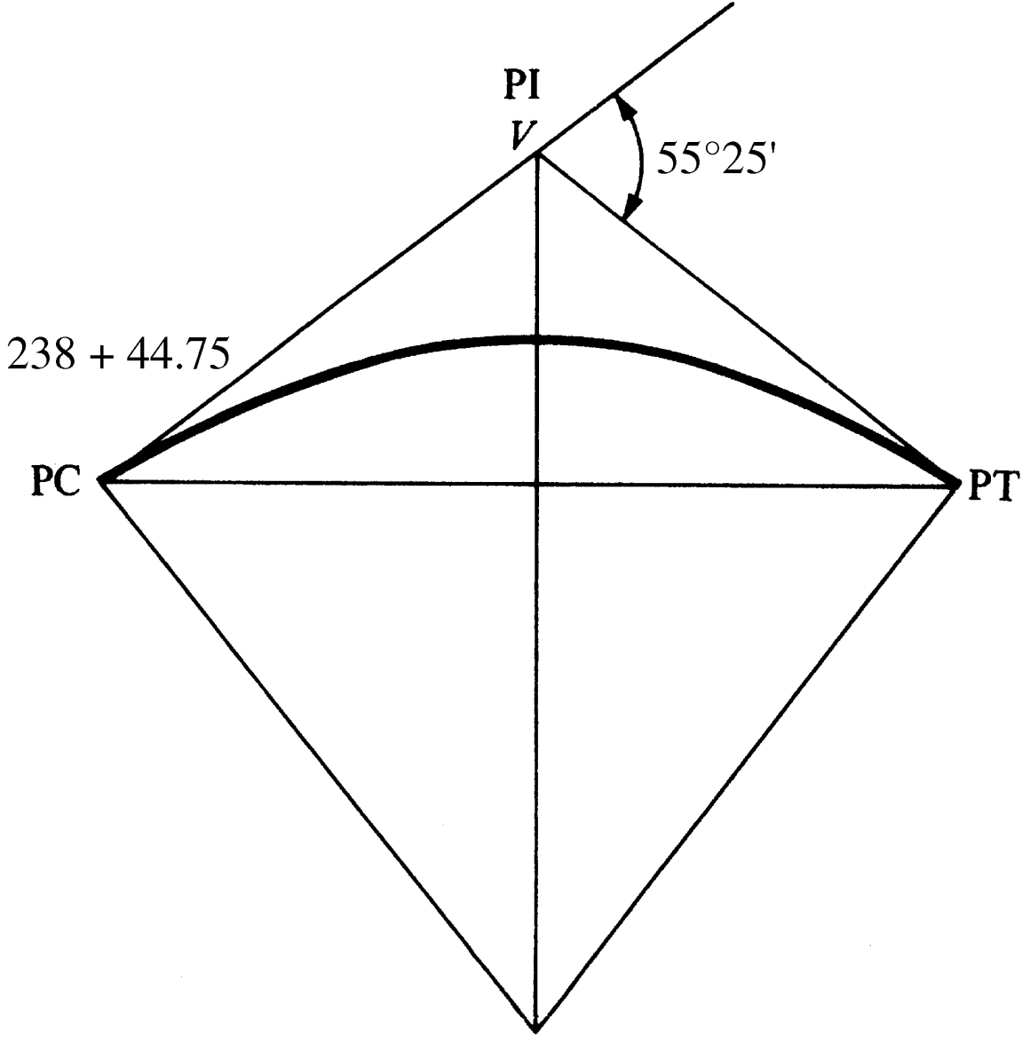
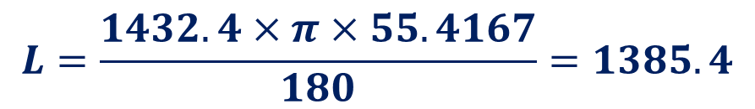
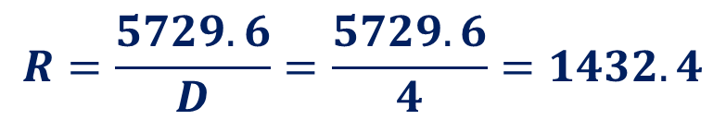
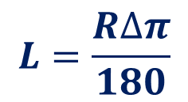
Example 7
The intersection angle of a 4° curve is 55°25’, and the PC is located at station 238 + 44.75. Determine the length of the curve, the station of the PT
Solution:
1- Determine the radius using degree of the curve D = 4°
$$R=\frac{5729.6}{D}=\frac{5729.6}{4}=1432.4$$
Radius of curve
Length of curve
$$L=\frac{R∆π}{180}$$
$$L=\frac{1432.4×π×55.4167}{180}=1385.4$$
2- The station at PT = station at PC + L
= 23844.75 + 1385.4 = 252 + 30.17

Slide 8
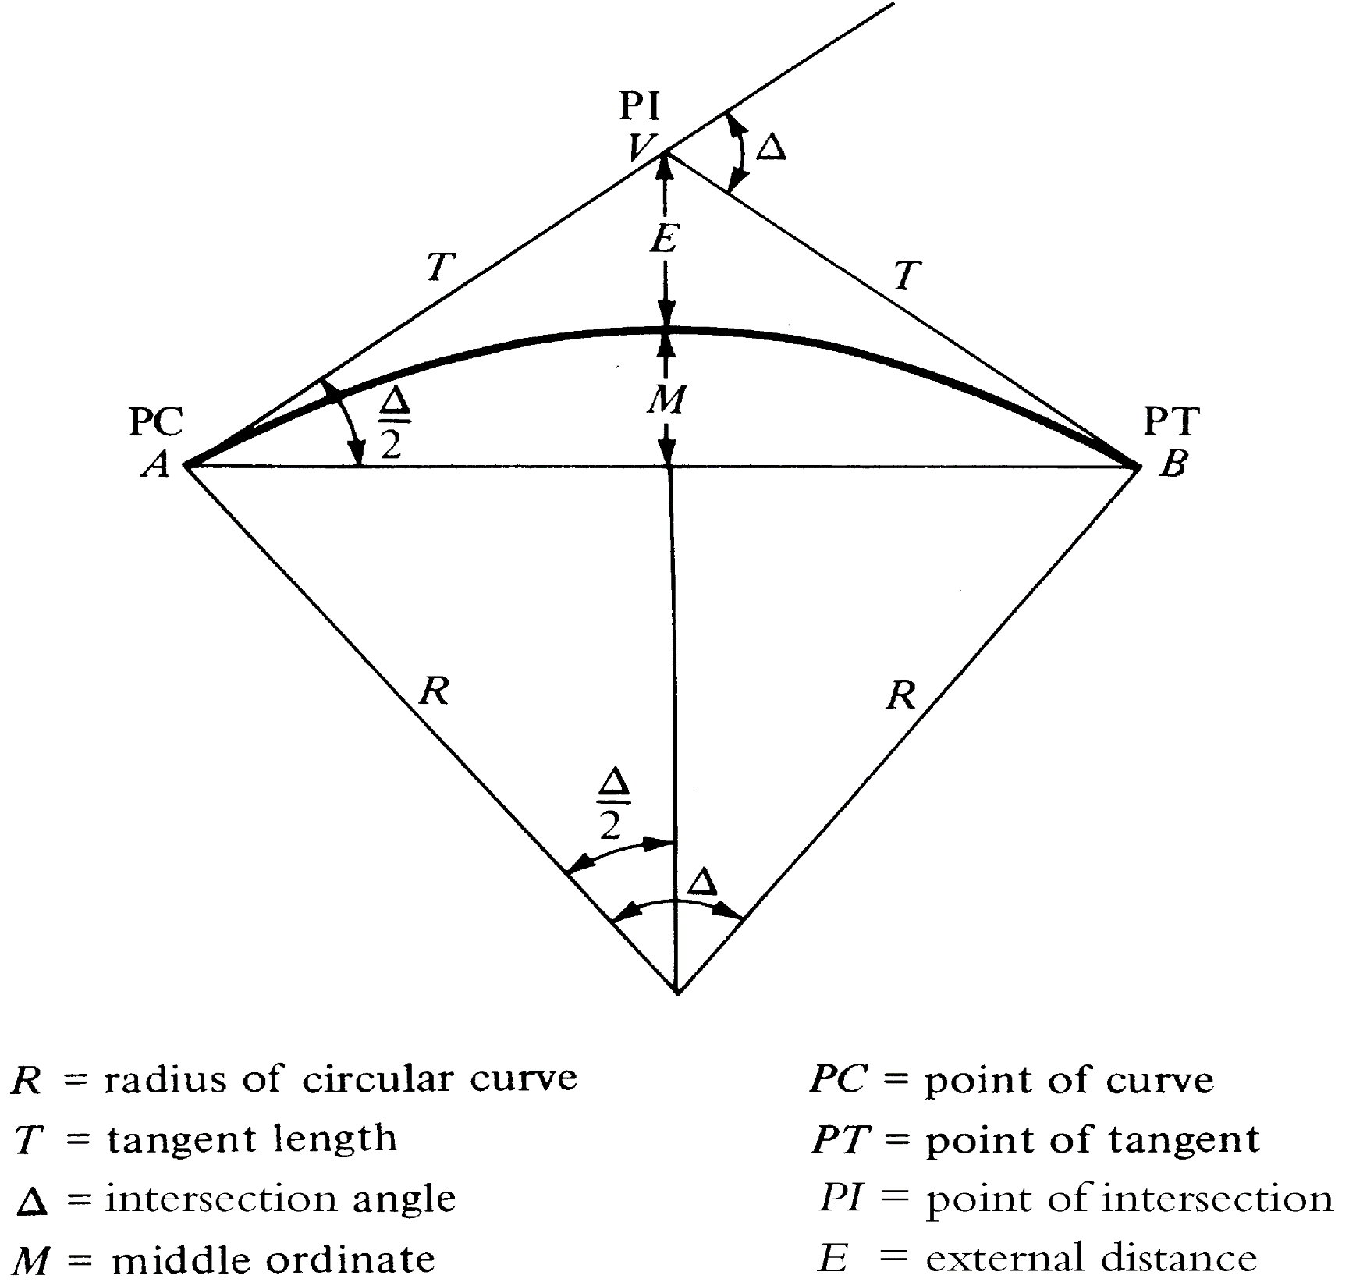
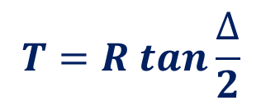
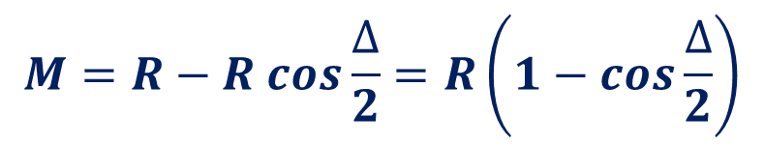
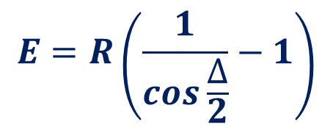
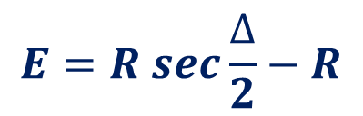
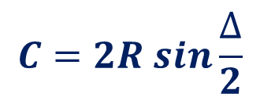
Formulas for Simple Curves
$$T=R tan\frac{∆}{2}$$
$$C=2R sin\frac{∆}{2}$$
$$E=R sec\frac{∆}{2}−R$$
$$E=R\left(\frac{1}{cos\frac{∆}{2}}−1\right)$$
$$M=R−R cos\frac{∆}{2}=R\left(1−cos\frac{∆}{2}\right)$$

Slide 9
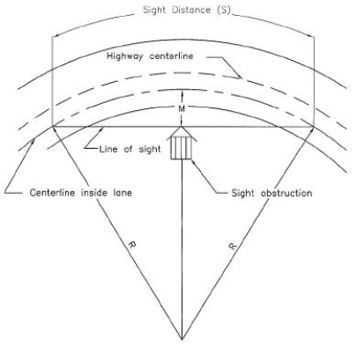
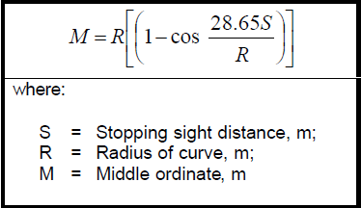
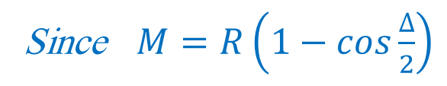
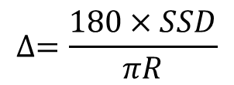
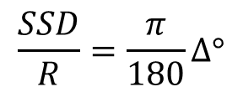
Sight Distance on Horizontal Curves
Stopping Sight Distance
The sight line is a chord of the curve
The stopping sight distance is measured along the centerline of the inside lane around the curve
$$\frac{SSD}{R}=\frac{π}{180}∆°$$
$$∆=\frac{180×SSD}{πR}$$
Since $M=R\left(1−cos\frac{∆}{2}\right)$

Slide 10
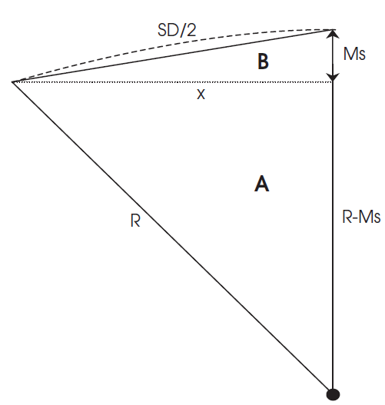
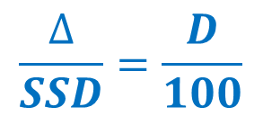
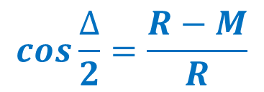
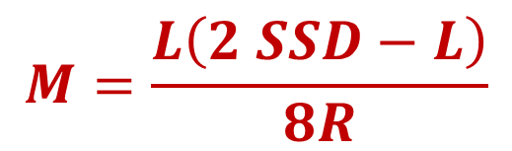
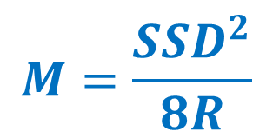
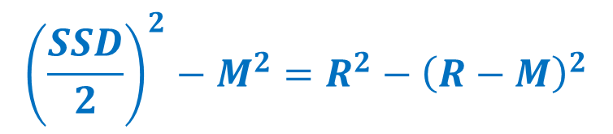
A more simplified approach is adopted
If SSD < L
$$cos\frac{∆}{2}=\frac{R−M}{R}$$
$$\frac{∆}{SSD}=\frac{D}{100}$$
$${\left(\frac{SSD}{2}\right)}^{2}−M^{2}=R^{2}−{\left(R−M\right)}^{2}$$
$$M=\frac{{SSD}^{2}}{8R}$$
$$M=\frac{L\left(2 SSD−L\right)}{8R}$$
If SSD > L

Slide 11
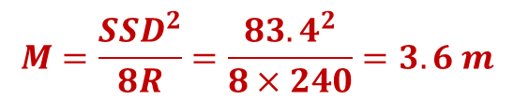
Example 8
A horizontal curve having R = 240m , design speed= 60km/hr. Determine the minimum distance an object can be placed from the centerline of the inside lane of the curve without reducing the required SSD. Assume a flat road segment, perception- reaction time =2.5 sec, f=0.34.
$$SSD=0.278.V.t+\frac{V^{2}}{254(f±G)}=0.278×60×2.5+\frac{{60}^{2}}{254×(0.34+0)}=83.4 m$$
$$M=\frac{{SSD}^{2}}{8R}=\frac{{83.4}^{2}}{8×240}=3.6 m$$
Example 9
H.W
If the direct length of the line of sight at a horizontal curve = 30m, the radius to the inside centerline of the curve= 50m. Find the minimum distance an object can be placed from the centerline of the inside lane of the curve without reducing the required SSD.

Slide 12
TRANSITION CURVE
The purpose of transition curves is to permit the gradual introduction of centrifugal forces
The radial acceleration experienced by the vehicle travelling at a given velocity (V )changes from zero on the tangent to (V2/R) when on the circular arc
The form of the transition curve should be (spiral) so that the rate of change in radial acceleration (C) is constant
Major axis
cubic parabola
Transition curve provides a convenient space
for super-elevation runoff and widening
Bernouilli`s lemniscates
spiral
Types of transition curves
45
o
45
o

Slide 13
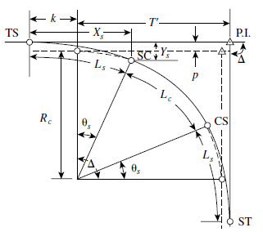
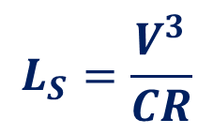
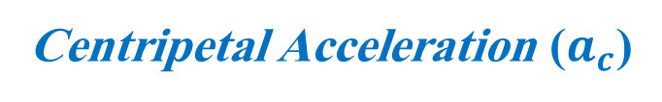
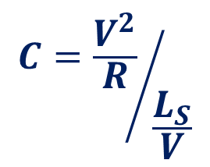
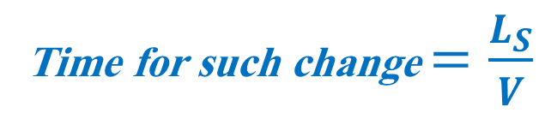

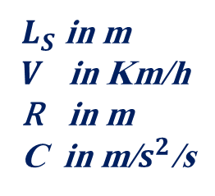
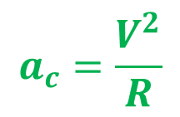
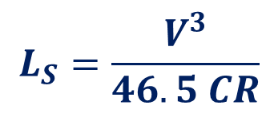
Spiral curve formula
Centripetal Acceleration ($a_{c}$)
$$a_{c}=\frac{V^{2}}{R}$$
On circular curve at S.C
$$a_{c}=0$$
On tangent at T.S
Time for such change $=\frac{L_{S}}{V}$
$${C=\frac{V^{2}}{R}}/{\frac{L_{S}}{V}}$$
Since C is the rate of change in centripetal acceleration
$$L_{S}=\frac{V^{3}}{CR}$$
$$L_{S}=\frac{V^{3}}{46.5 CR}$$
$L_{S}$ in m
$V$ in Km/h
R in m
C in m/$s^{2}$/s
C = 0.9 – 1.4 for comfort and safety

Slide 14
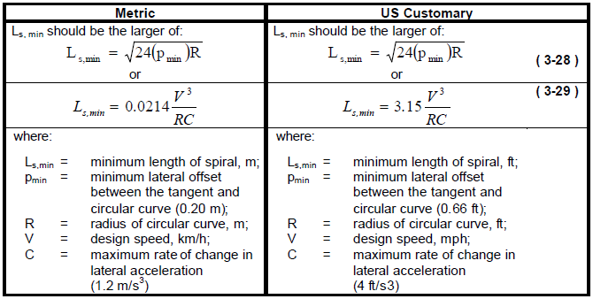

Slide 15
SUPERELEVATION
The inclination of the roadway toward the center of the curve is known as superelevation
When a vehicle is moving around a circular curve it endures a centrifugal acceleration
In order to balance the effect of the centrifugal acceleration, the road is inclined toward the center of the curve

